Slide 1
BASH PROJECT
USER EASE MANAGER
MenTor :-
Pratush Sir
Team MEMBERS => DIVYANSHU
=> Vaibhav
=> SUNNY
PINE TRAINING ACADEMY (Group-5)

Slide 2
EXPLANATION :-
This project is to build a menu system for a new user.
However, it will also allow for some more advanced features, such as allowing the user to use wild cards.
In all cases, WE must provide error checking to make sure the user does not attempt something that will not work. (This would include such things as did the user enter a filename when one is required. You don't have to worry about whether or not the user entered a valid filename was entered, because the command will do that.)

Slide 3

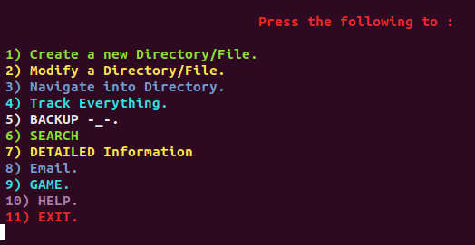

MAIN / HOME

Slide 4
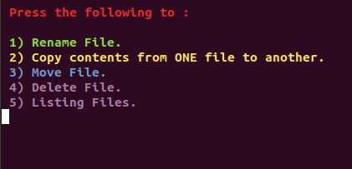
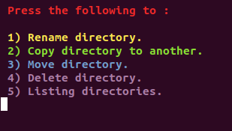
MODIFY a file / directory

Slide 5
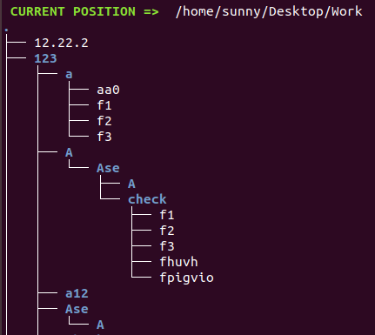
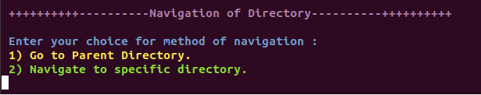
NAVIGATION TRACK

Slide 6
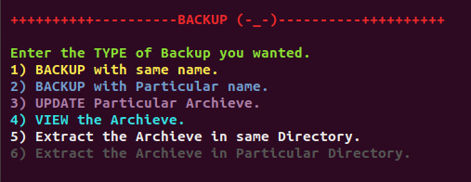
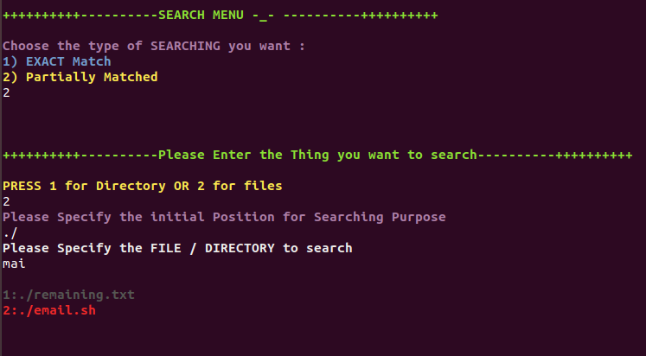
BACKUP SEARCH

Slide 7
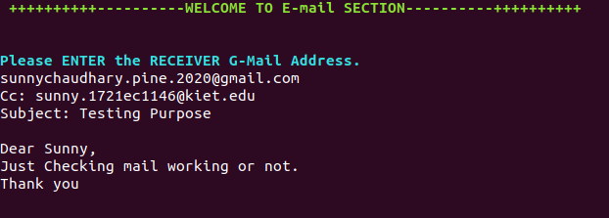
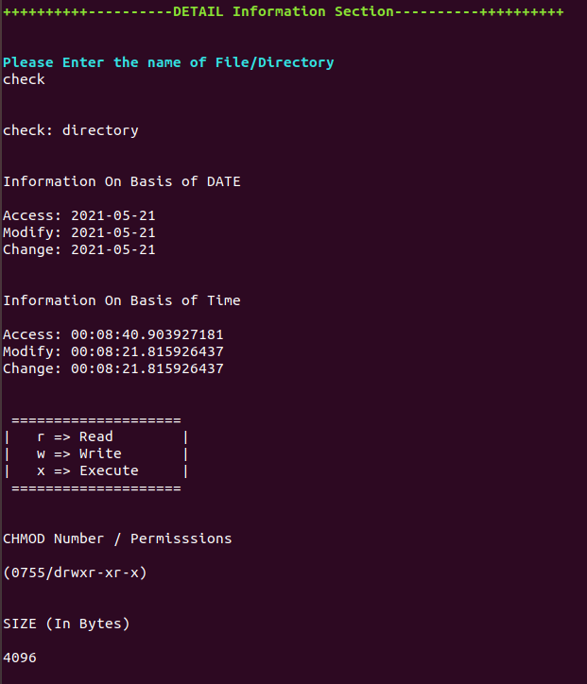
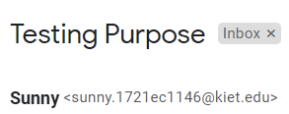
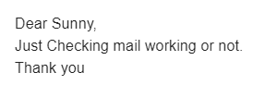
E-MAIL DETAILED INFORMATION

Slide 8
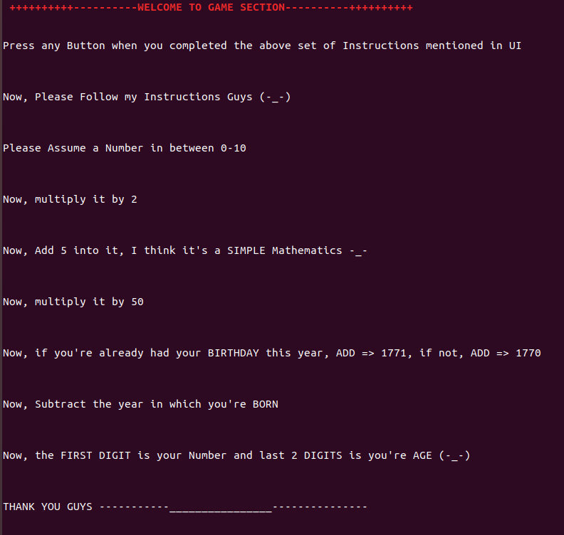
GAME ( ADDITIONAL )

Slide 9
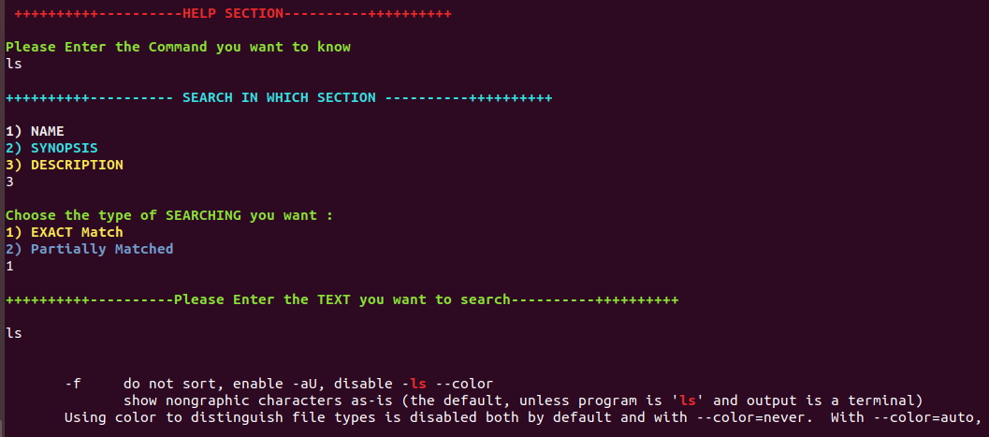
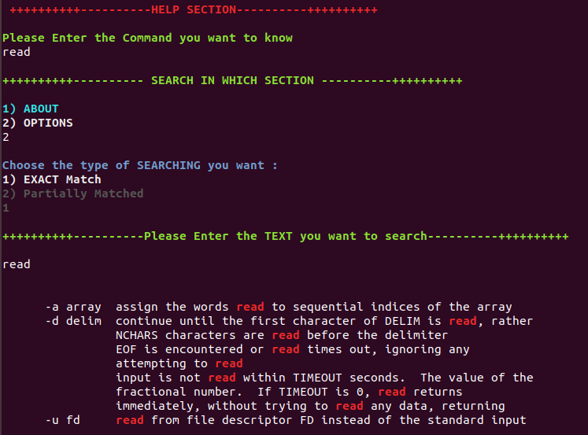
HELP SECTION

Slide 10
THANK YOU

